Slide 1
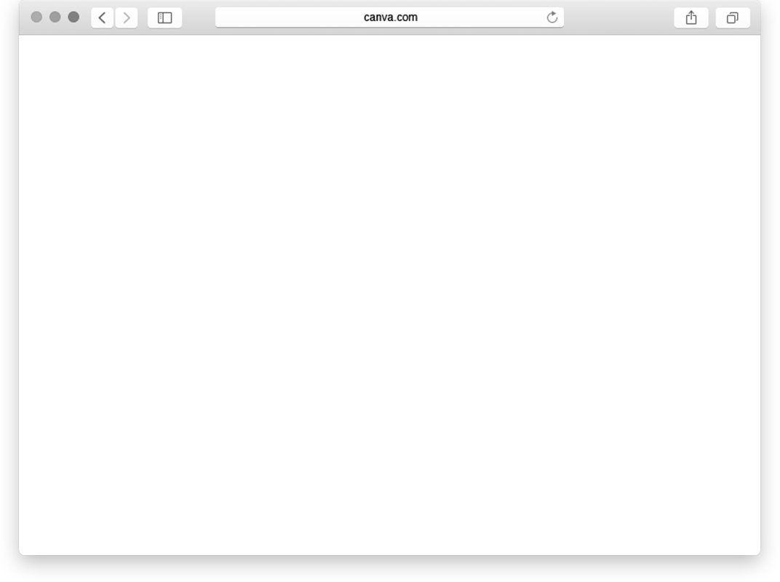
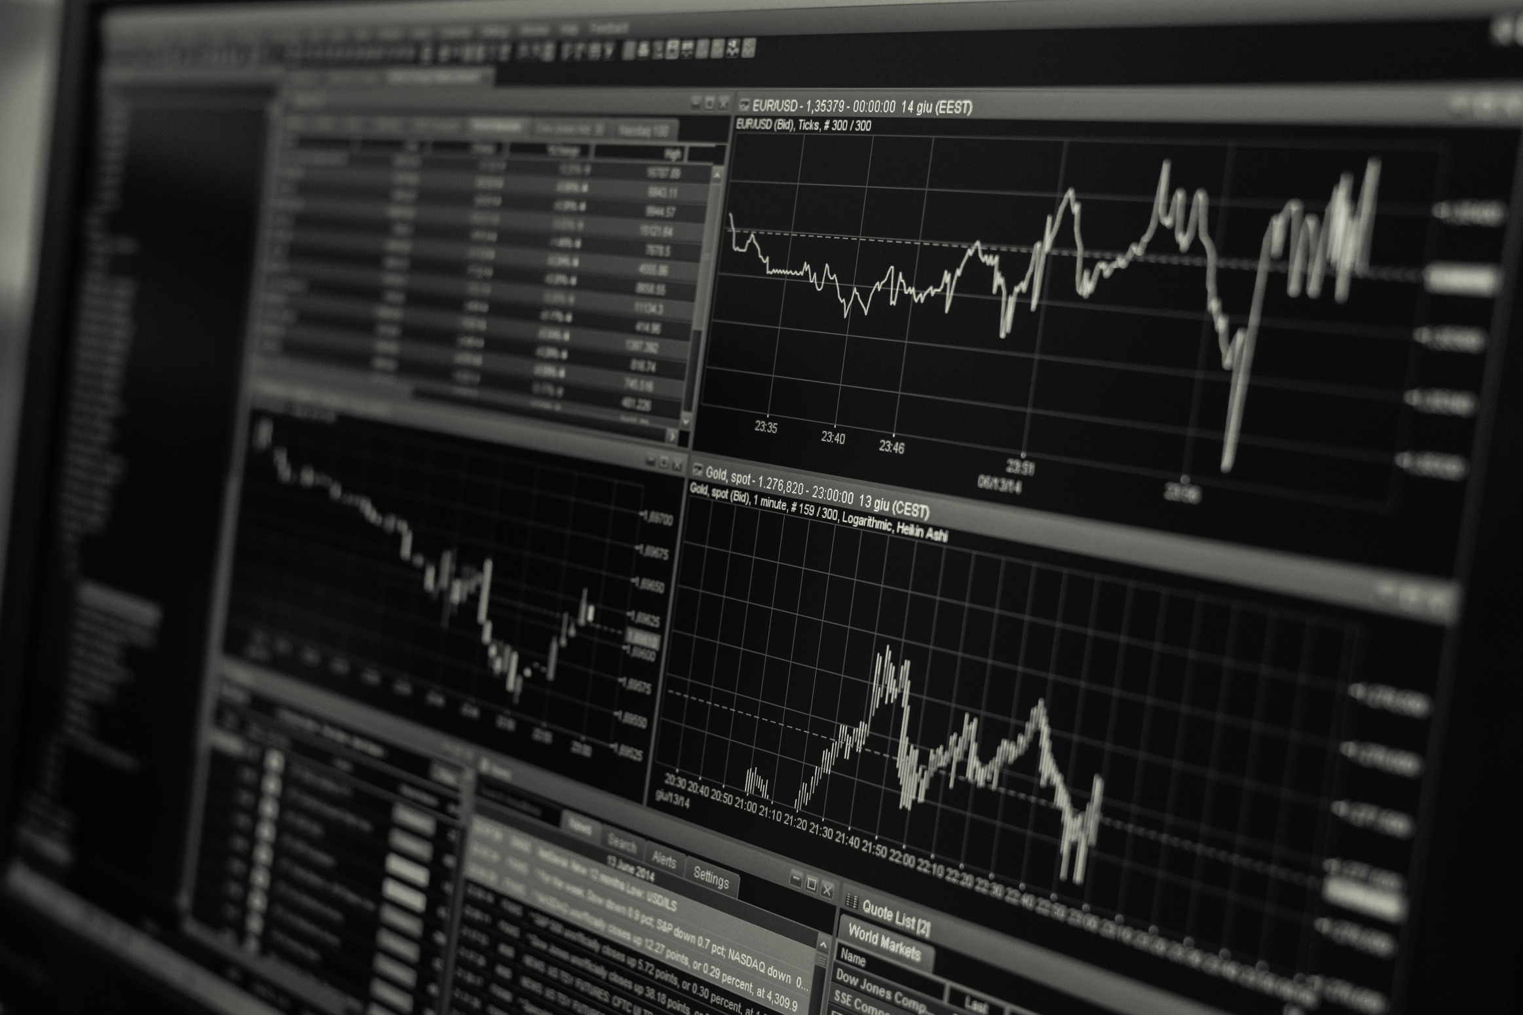
FINANCIAL ASSET MANAGEMENT
TEAM MEMBERS
TEJAS BAWANKAR
KRISHIKA SINGH
GAURI PASARKAR
KARAN AGRAWAL

Slide 2

Problem Background
Many people invest in stock market, mutual funds etc.
However, investors lack a singular platform where they can store their data, analyze their investments and prepare for next sets of investments based on the returns.
The data is abundant but less exposure to insightful information. With this background on the problem in our mind, we aim to solve it!

Slide 3

Problem Statement
Investors do not have an integrated view of their investments which, if they had, would leverage them to make rapid investment decisions to track their economic growth - present and future.

Slide 4
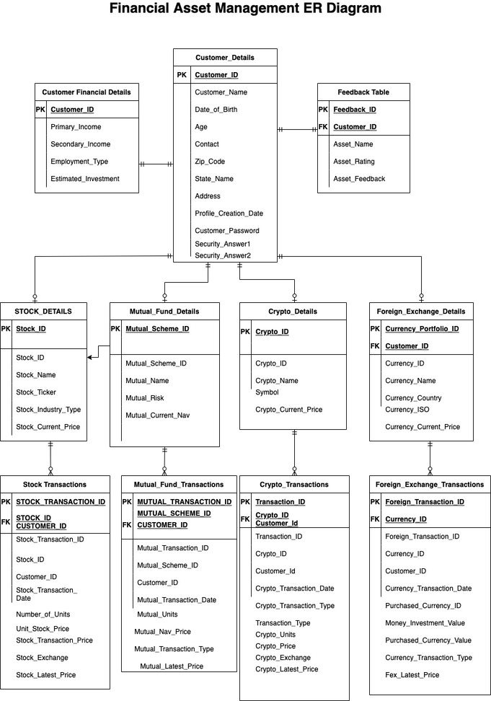
ERD

Slide 5


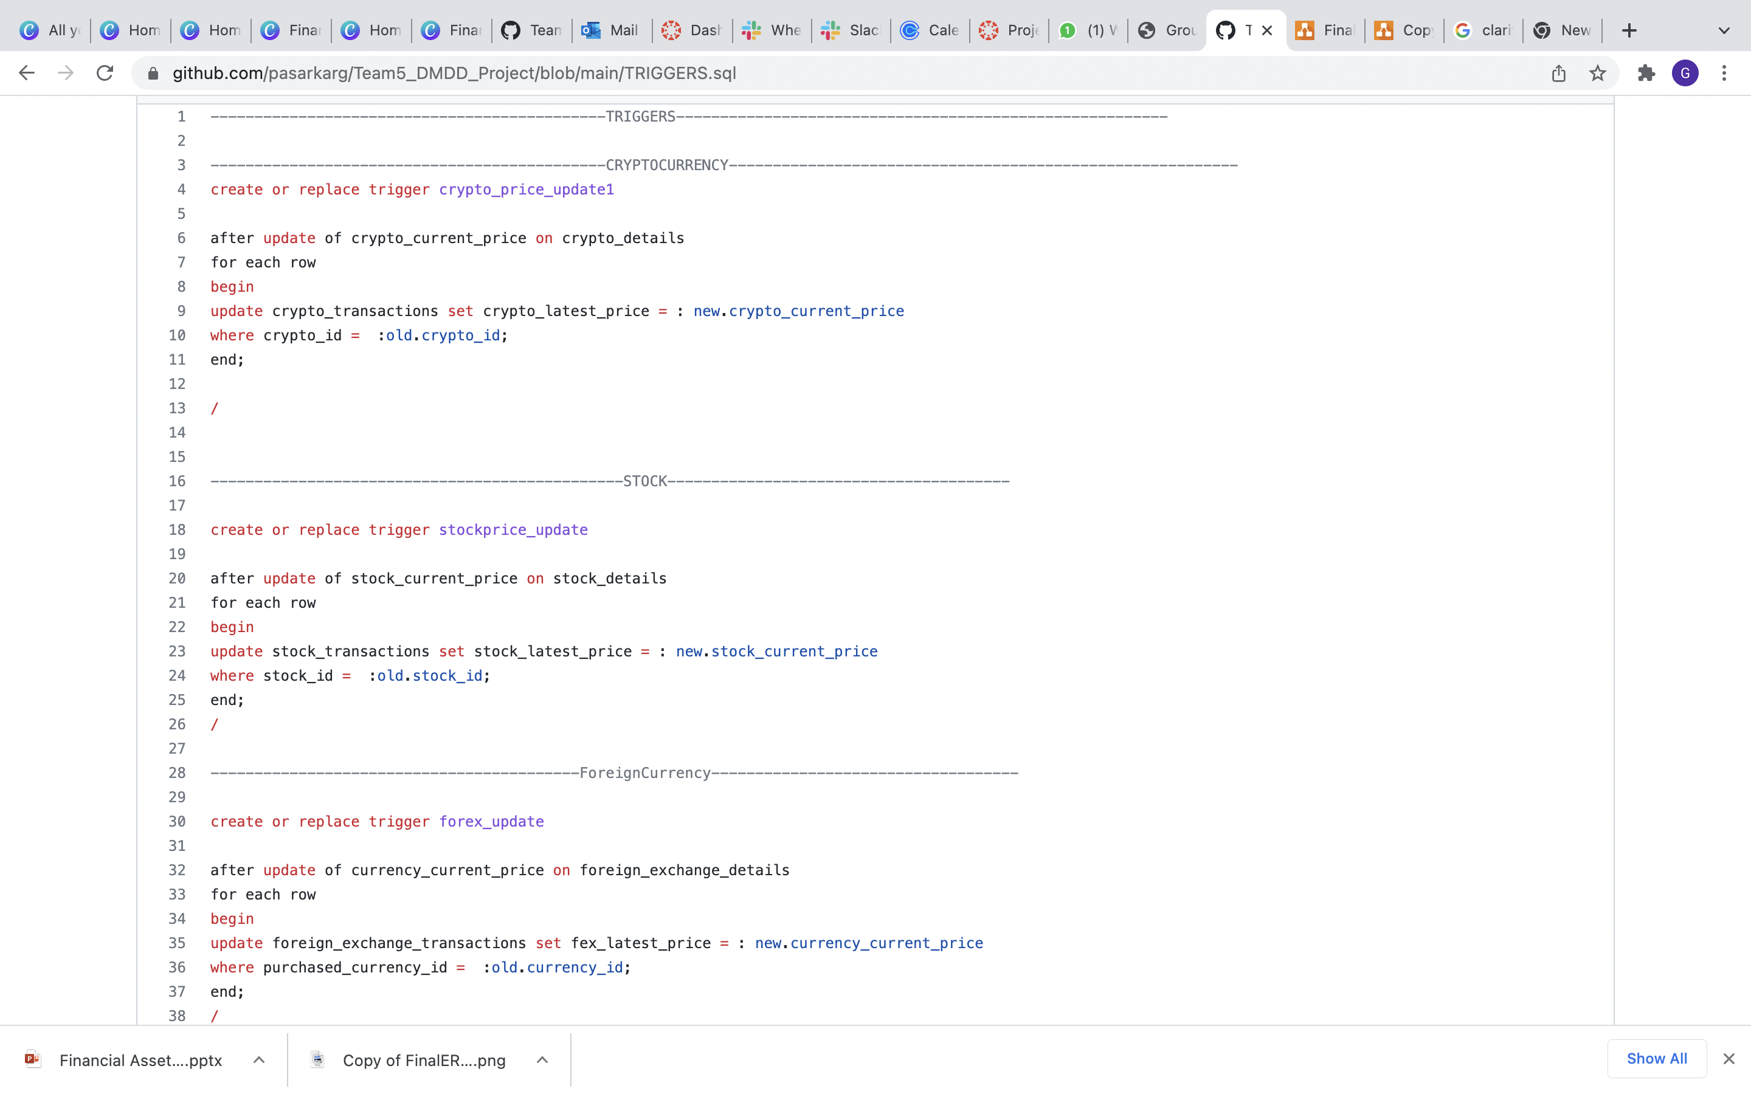
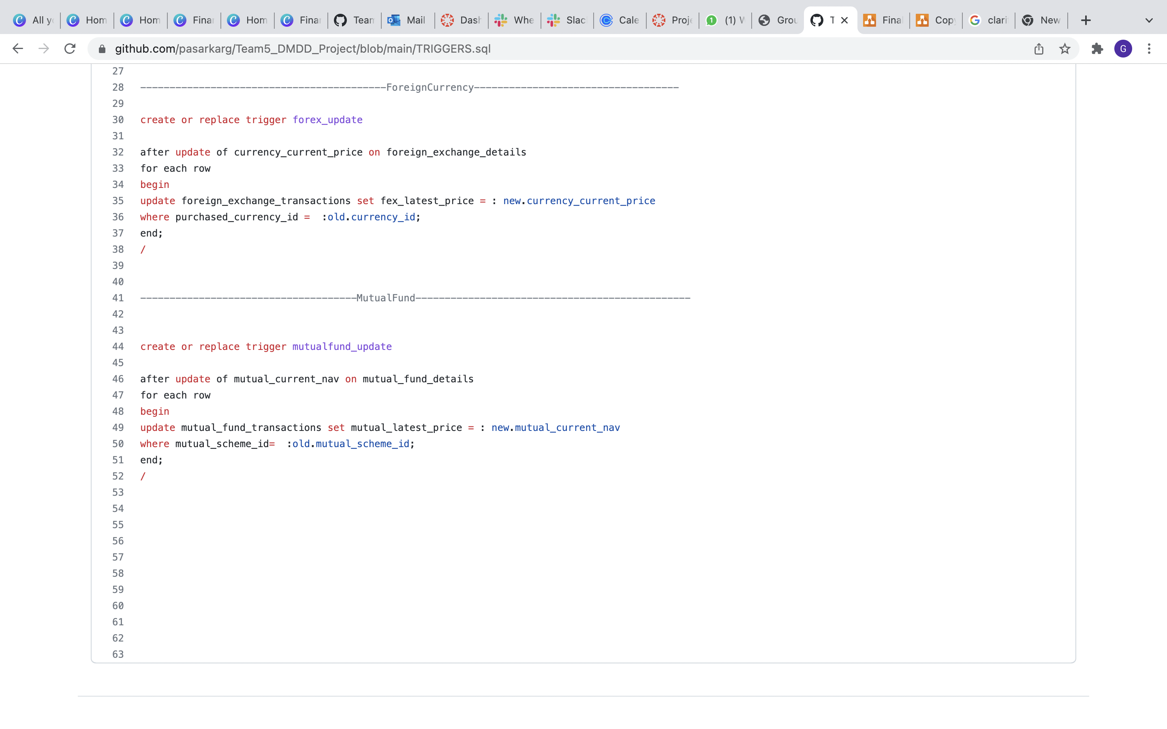

Slide 6

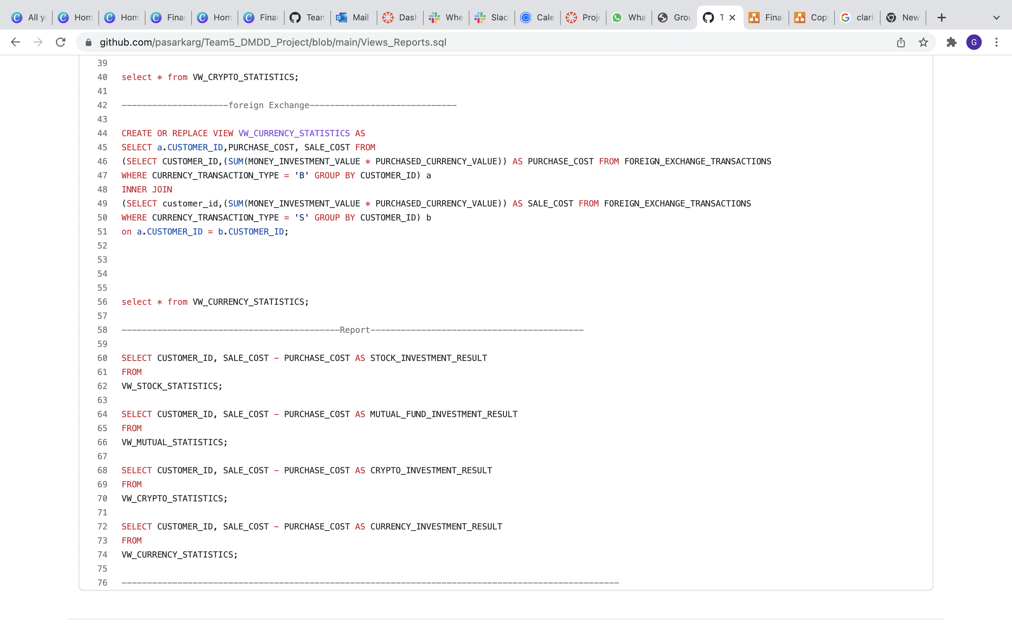
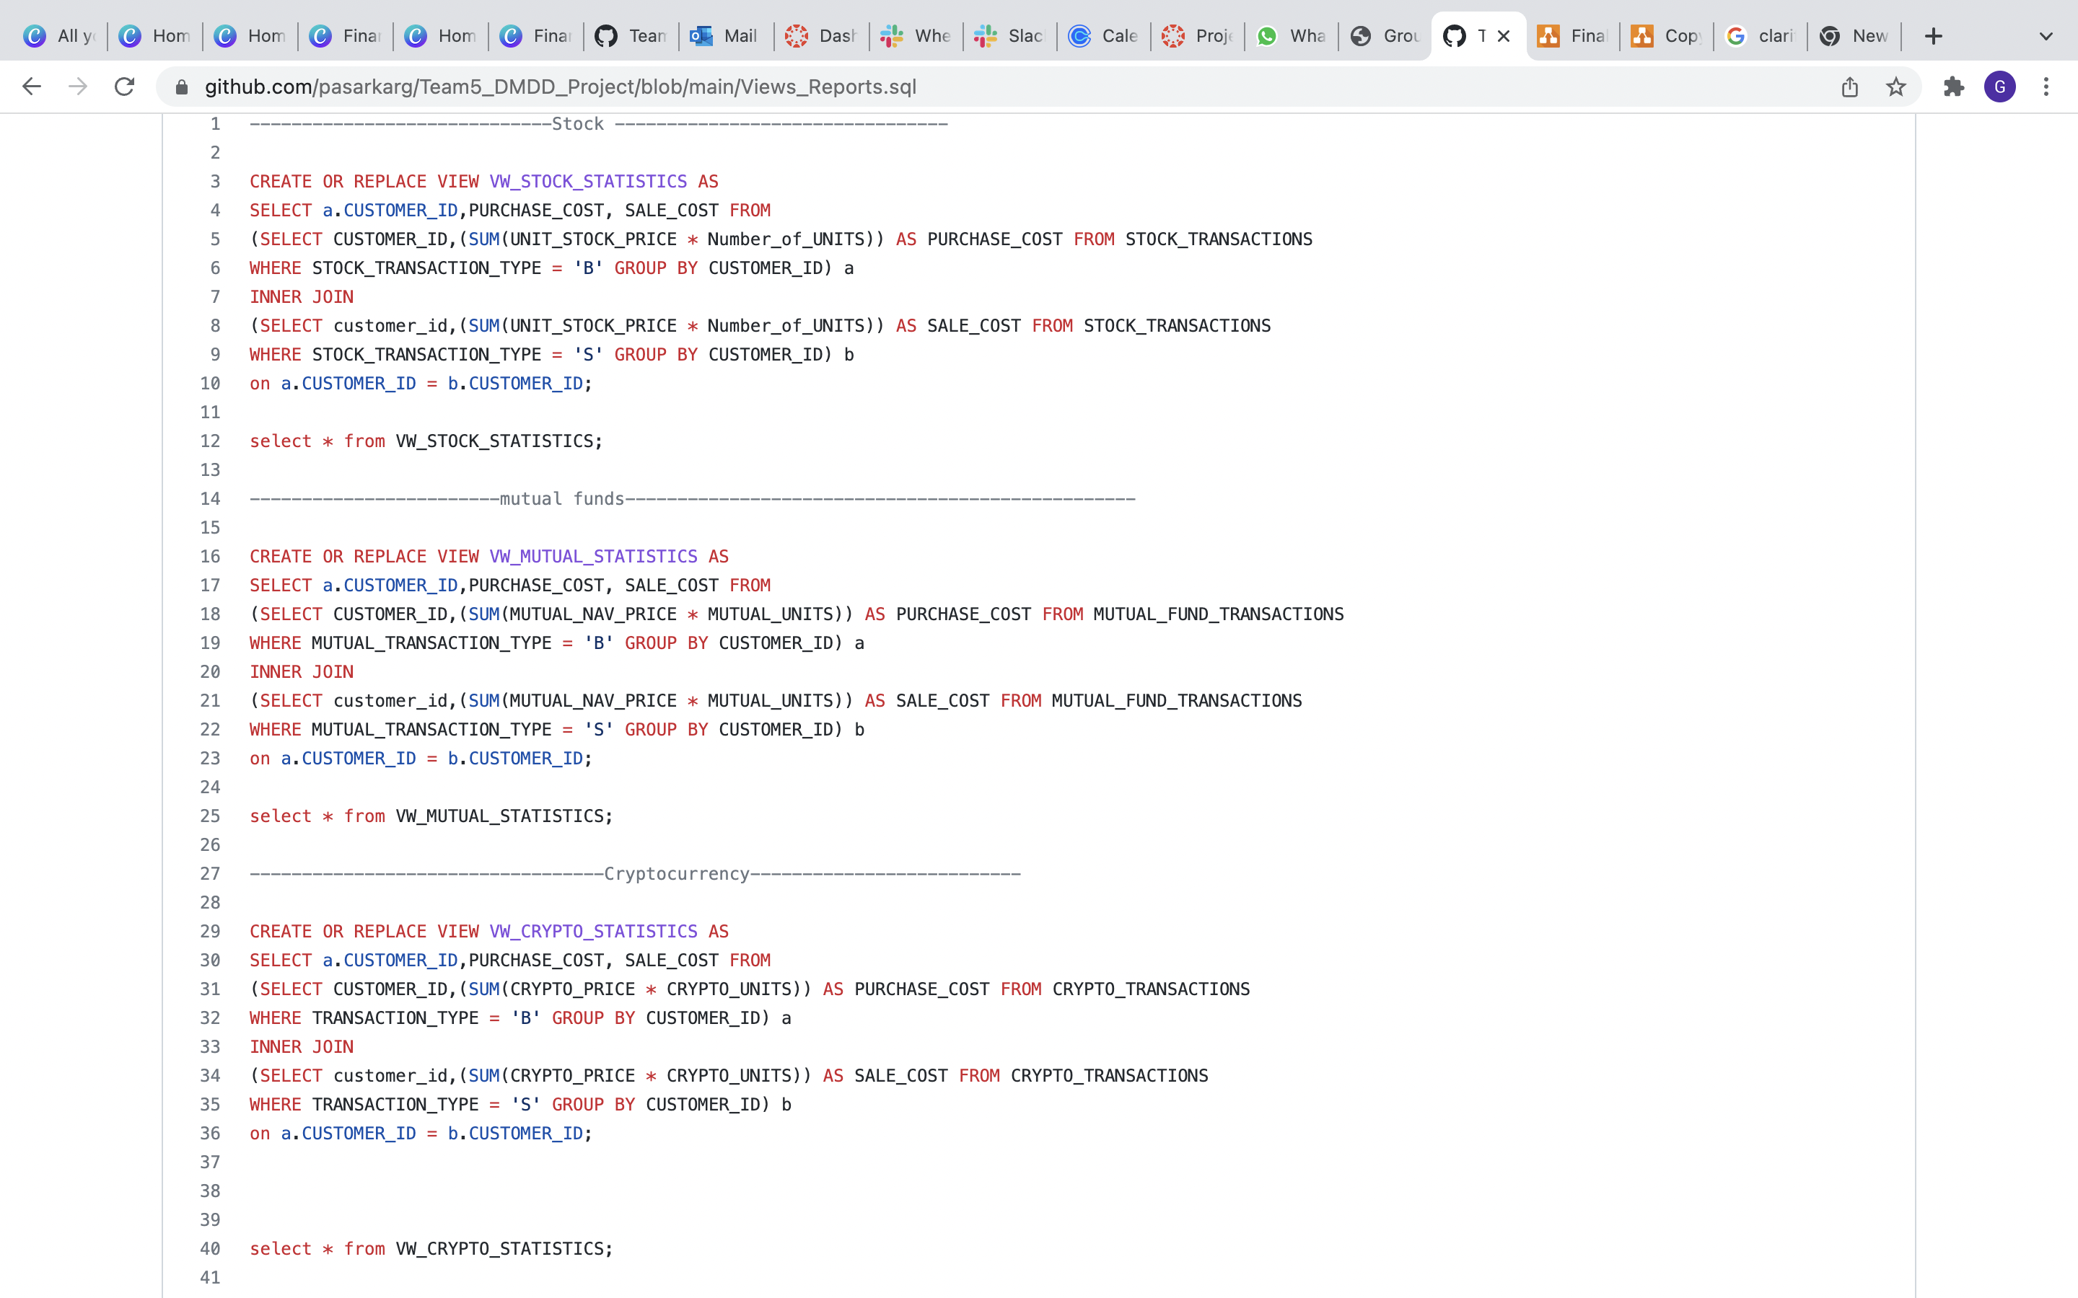

Slide 7
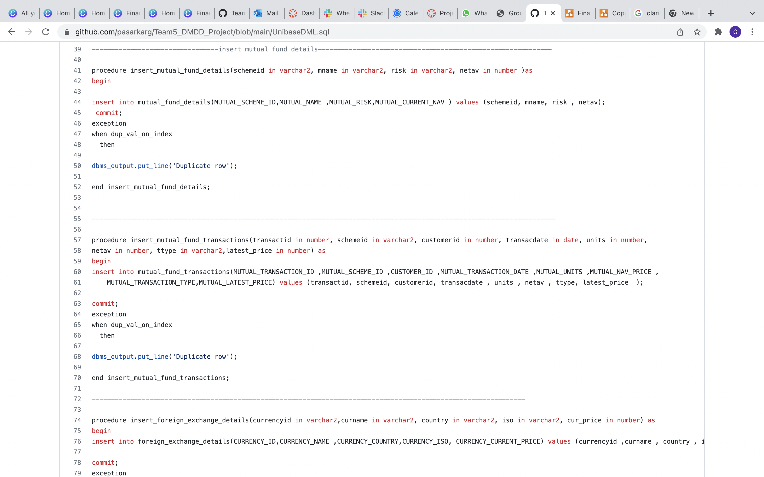
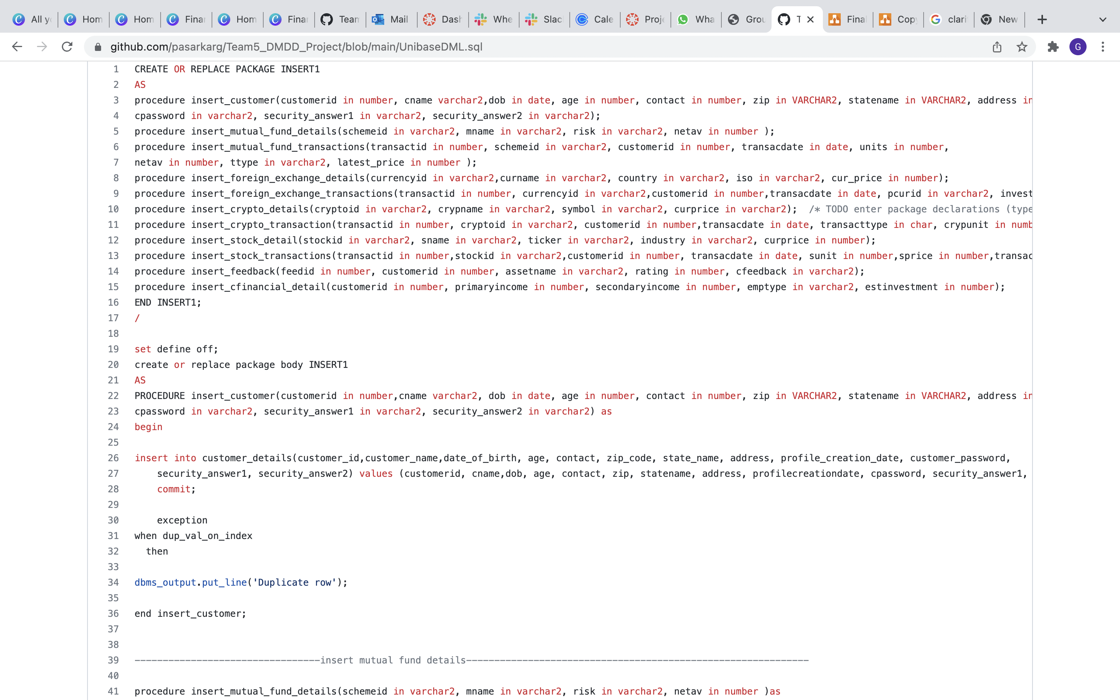

Slide 8
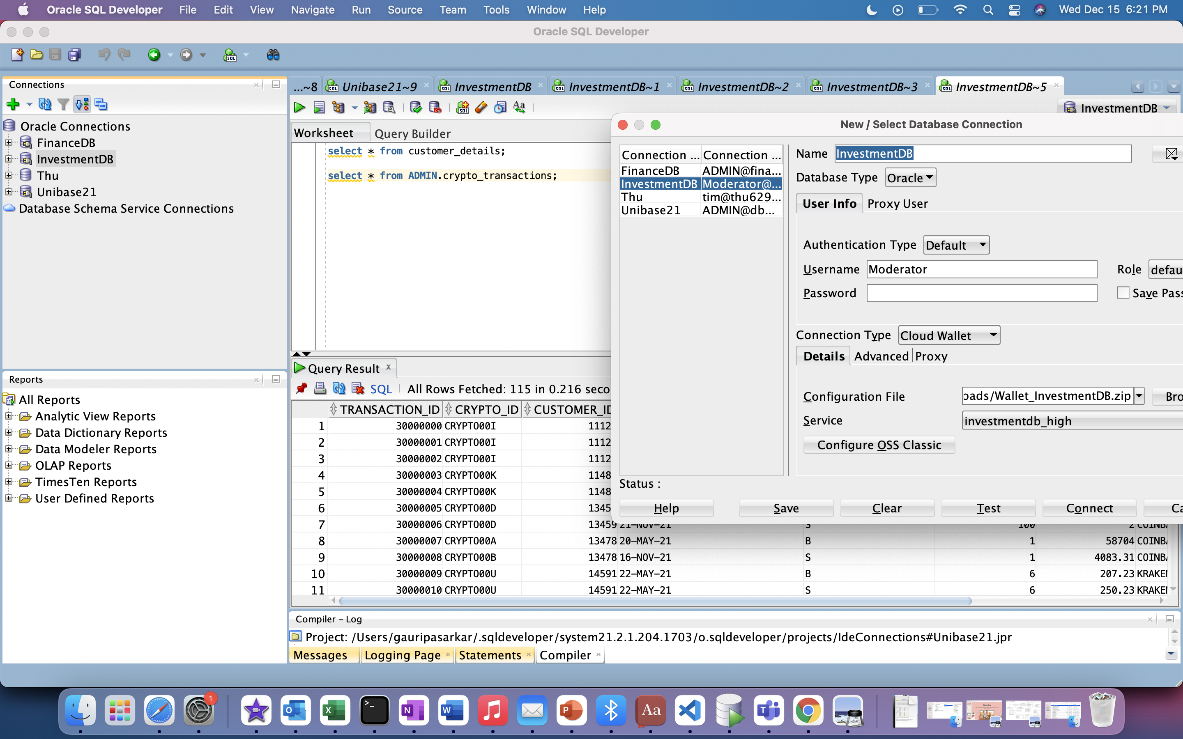
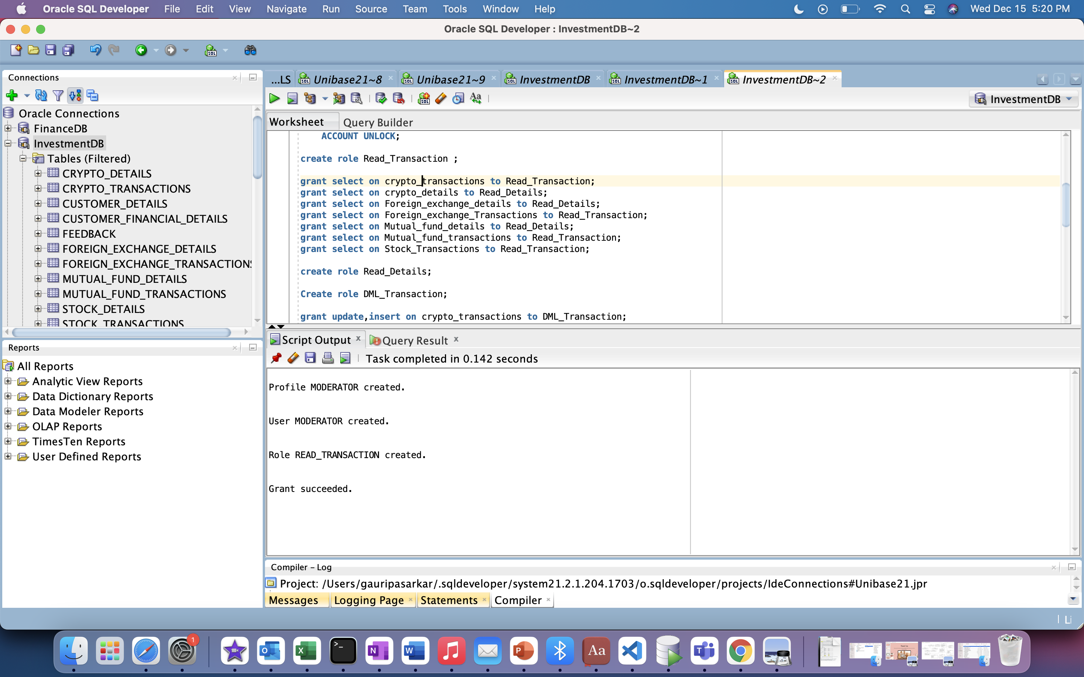

Slide 9


Team Contribution
Tables & Related implementation
Stock Tables-Karan
Mutual Fund Tables-Gauri
Crypto Tables-Krishika
FOREIGN_EXCHANGE Tables –Tejas
Customer Details-Karan
Customer financial details-Krishika
Feedback Table-Gauri
Integration-Tejas

Slide 10
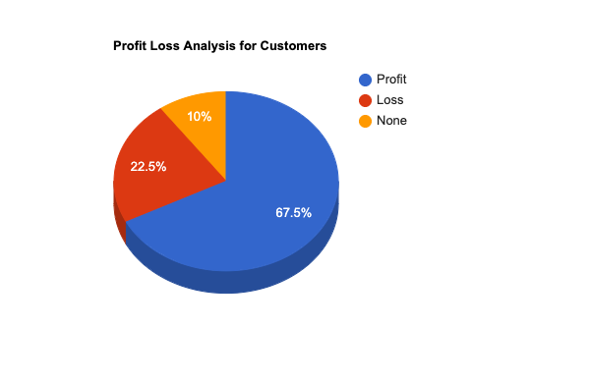

Slide 11
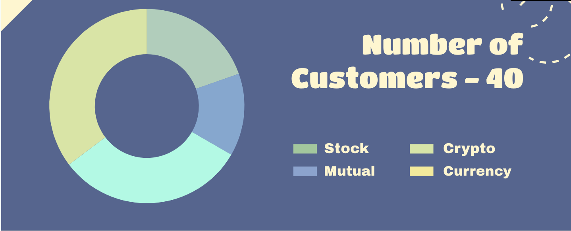

Slide 12
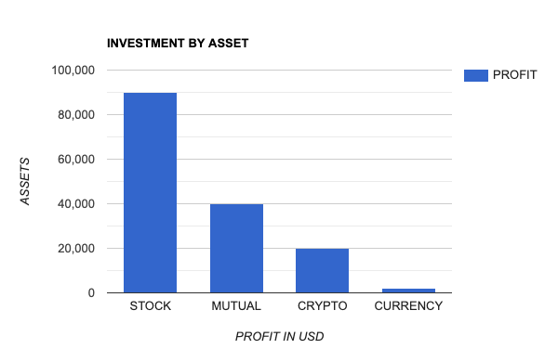
.

Slide 13
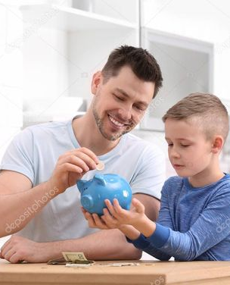
Thank You

